Slide 1

MargDarshan: AI-based Career Guidance System
Empowering students with personalized, data-driven career pathways.

Slide 2

Project Team
Project Title
Presented By
MargDarshan: AI-based Career Guidance System
Nikhil Chandrakesh Gupta
Personalized Career Recommendation using ML Algorithms
Department of CS and IT , Ramnarain Ruia Autonomous college
This presentation outlines the development and potential of MargDarshan, an innovative AI system designed to transform career guidance for engineering and computer science students.

Slide 3
The Challenge: Navigating Career Paths
Reliance on Informal Advice
Biased & Limited Suggestions
Students primarily seek guidance from seniors, mentors, professors, and parents.
Personal experiences often lead to subjective advice and a lack of awareness of diverse career options.
Accessibility & Cost Barriers
Uncertain Outcomes
Professional counseling can be expensive and not readily available to all students.
Traditional methods offer no guarantee of aligning students with their optimal career paths.
These drawbacks highlight a critical need for an objective, comprehensive, and accessible career guidance solution.

Slide 4



Foundational Assumptions for MargDarshan
Interest & Vision
Holistic Profiling
Comprehensive Parameters
The system assumes students possess a fundamental interest and vision, categorized as either Management or Technical.
Key personal attributes like personality, skills, and past academic performance are considered crucial for effective recommendation.
The system incorporates data from 38 identified parameters, including academic records, technical proficiencies, hobbies, and psychometric assessments.
These assumptions form the bedrock for creating a truly personalized and relevant career guidance experience.

Slide 5
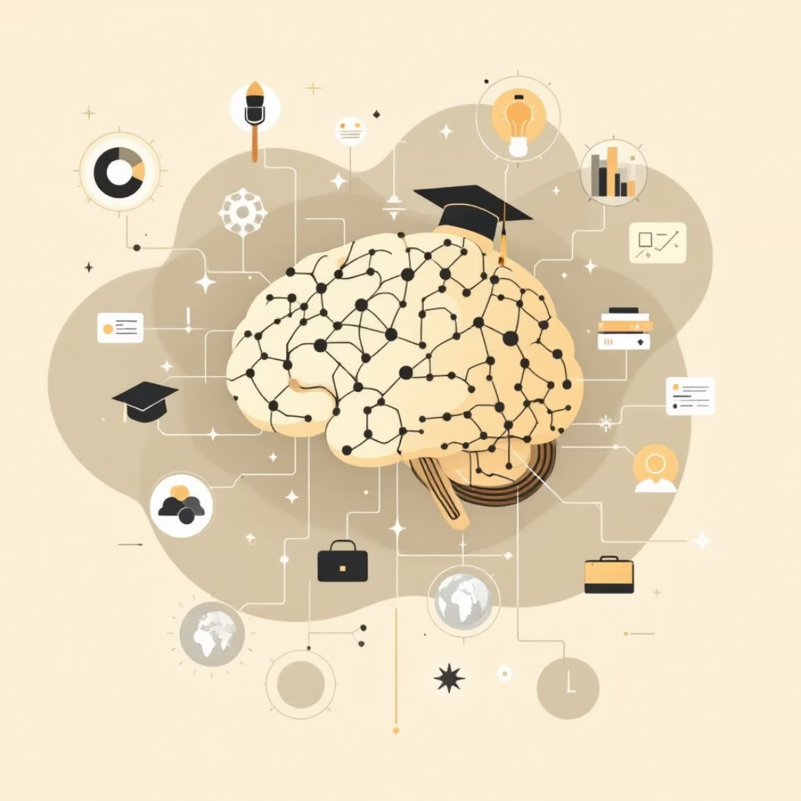
Our Solution: MargDarshan - AI-Based Career Guidance
MargDarshan is an AI-powered system designed to provide personalized career recommendations by analyzing a comprehensive set of student attributes.
Integrates data from:
Academics and skills
Personal interests and psychometry
Hobbies and extracurriculars
Utilizes machine learning algorithms for robust multiclass classification.
This objective and unbiased approach aims to suggest job roles that are truly suitable for each individual student.

Slide 6
System Comparison: Existing vs. MargDarshan
Relies on people (seniors, parents, counselors)
Data-driven, unbiased recommendations
Prone to bias & limited knowledge
Utilizes multiple ML models for accuracy
Costly & uncertain outcomes
Free & accessible career insights
MargDarshan offers a significant leap forward in career guidance by leveraging technology for superior precision and fairness.

Slide 7

MargDarshan: System Workflow
Data Collection
Pre-processing
One-Hot Encoding
Model Selection
This structured flow ensures a systematic and accurate approach to career recommendation, culminating in an intuitive user experience.

Slide 8
Implementation Details
Data Collection
Algorithms Explored
Academic scores & specialization
Our research involved testing a range of robust machine learning algorithms:
Technical skills & certifications
Hobbies & extracurriculars
Support Vector Machine (SVM): Demonstrating strong performance in classification tasks.
Data Pre-processing
Decision Tree: Explored with both Entropy and Gini impurity criteria.
Cleaning raw data
Handling null values
Random Forest: An ensemble method for improved accuracy.
Replacing garbage values
K-Nearest Neighbors (KNN): A non-parametric method for pattern recognition.
XGBoost: While tested, it was not ultimately selected for the final model.

Slide 9
Key Results and Findings
The current version of MargDarshan was trained using a randomly generated dummy dataset. This was a necessary step due to the unavailability of a real, comprehensive dataset for career guidance.
78%
SVM
As expected, the absence of real-world data led to a notable drop in overall accuracy during evaluation. However, this foundational work provides a clear path forward.
SVM consistently outperformed other models, showcasing its potential for this specific classification task.
75%
Decision Tree
Both Entropy and Gini criteria yielded comparable results, close to SVM.
76%
Random Forest
Showed good generalization ability, similar to DT.
74%
KNN
Provided consistent performance in line with other models.
The relative performance of the models remains valuable, indicating SVM as the most promising candidate for future development with real data.

Slide 10


Conclusion & Future Outlook
AI-Assisted Guidance
Automated Recommendations
Scalability with Real Data
AI can significantly assist students in receiving unbiased career guidance, removing personal predispositions from the process.
Machine Learning models provide a robust framework for automated and efficient career recommendations.
While currently trained on a dummy dataset, MargDarshan is designed to be highly scalable and will deliver far more accurate results with real, diverse student data.
MargDarshan represents a vital step towards a more equitable and effective system for student career development.

